Slide 1

Clinical Concepts for Healthcare Information Sharing
The Ontic & Epistemic Model

Slide 2
Challenge one – Information is messy. People complicated
How do we know when two schema “mean the same thing”?
Clinical information sharing is currently defined by modeling the data as needed for a particular application or situation
While vast effort has been expended to “connect the dots” with “pre-coordinated codes” and data mappings, the complexity of the domain shows the inherent weakness in focusing on data for a particular purpose rather than the domain – people, their conditions and healthcare.
But, people, their conditions and healthcare are very complicated, making solutions hard to understand or to scale.
Health record or message schema
Health record or message schema

Slide 3


The “real world” and records of it get conflated
Health Record
Vital sign Observation
Patient: John Snow
Time: 10:30am 3/21/2010
Taken By: Sue Miller
Topic: Body Temperature
Value: 101.5
Unit: DF
…
Related but not the same thing
At 10:30AM 3/21/2021 John’s body temperature was 101.5 degrees Fahrenheit
But you can’t understand the data without the real-world concept and you can’t communicate the concept without data

Slide 4

And it gets worse
People and healthcare situations are extremely dynamic, change and time is critical – many data schema and ontologies do not handle time well
Evidence is indirect, often assumed based on complex measurements
Critical decisions have to be made on incomplete and sometimes contradictory information
Context is critical

Slide 5
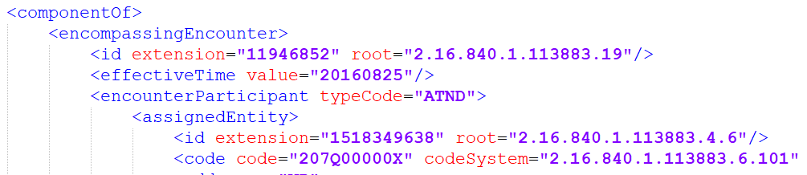
MDMI depends on consistent and unique meaning
“Simple” question: What does this mean?
MDMI Business Element

Slide 6
Approach to solution
Create a model encompassing both Ontic (about the “real world”) and Epistemic (About what we know, share and record)
Connect the record to what it is about
Represent both based on Situations – conceptual groupings of related things and values over a time period
Situations can be as granular as John’s temperature or as large as the Corona-19 Virus
Situation semantics has a long history, pioneered by Jon Barwise and John Perry in the early 1980s
Provide the basis for context
Roles things play V.s the things playing the roles
Understanding how the same thing may have different characteristics and relationships in different roles
Leverage detailed concepts in other vocabularies, code lists, and models
Provide a unifying framework without trying to model all of biology and healthcare
Provide a general framework which is then specialized to clinical healthcare

Slide 7
What are situations?
Situation | Not a situation
A cup falling off of a table | A cup
The Novel Corona Pandemic | Covid-19
The lifetime of George Washington | George Washington
The height of a person (or any other physical characteristic) at a particular time. | 6 feet
The change of a person’s temperature over a timeframe (or any other change) | 2 Degrees per hour
Sue’s obligation for a person to pay for a medical service | The general concept of a medical service
John’s healthcare appointment at 2PM | John

Slide 8
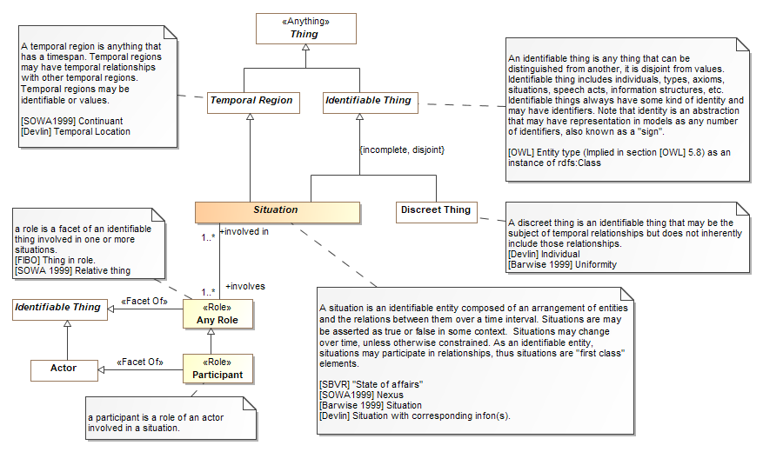

Slide 9
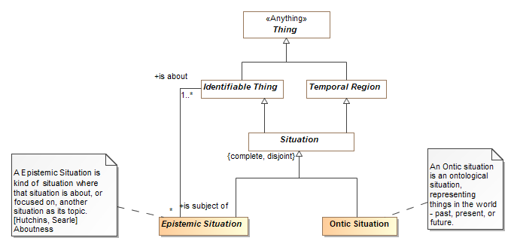
The “Ontic” / “Epistemic Partition

Slide 10
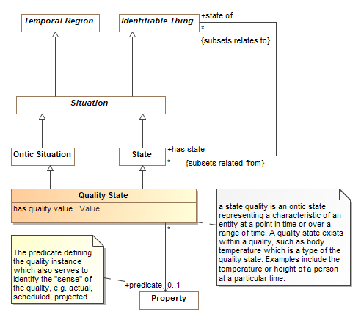
Qualities
The most “atomic” situation is a “quality” of something over a timeframe
Think of qualities as temporal attributes, like body temperature, that changes over time for a particular individual

Slide 11
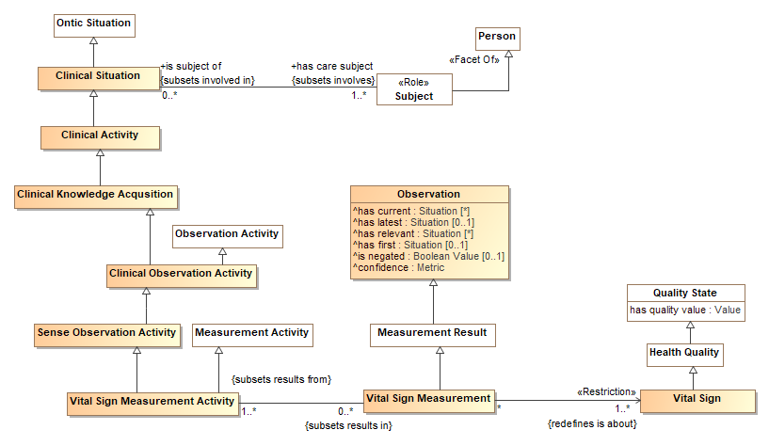
Linking to domain Concepts
Skipping down a few levels…

Slide 12
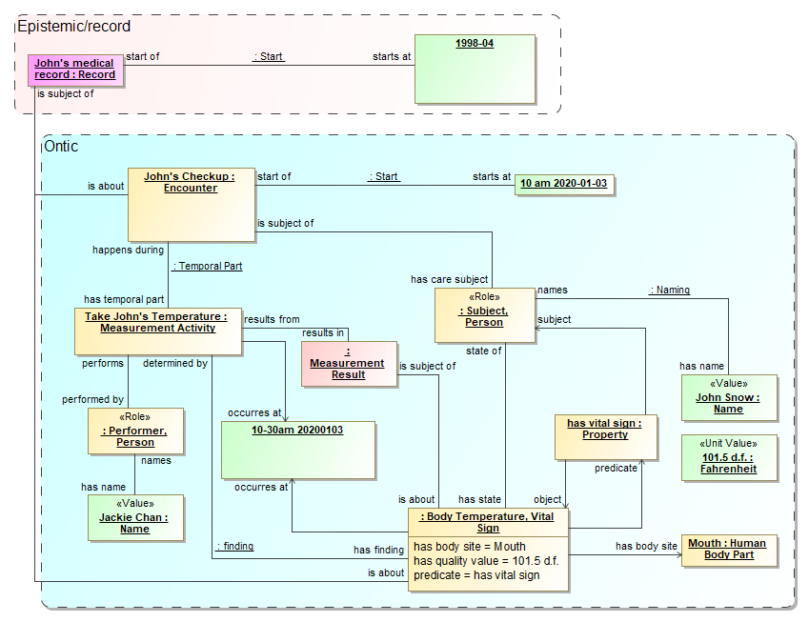
An instance example

Slide 13
MDMI Business Elements are defined by a “path” through the model
MDMI uses the model as a reference for meaning, not to enable inference of actual data.
Given a starting point, a class in the model, a “path” through that model, including relationships and constraints, ends in a particular value
That path fully and uniquely defines a business elements meaning
A path is like an OWL property chain, but the “chain” may be constrained at each “hop” constrained based on types and restrictions
Lets look at:
VitalSignObservationAuthorName

Slide 14
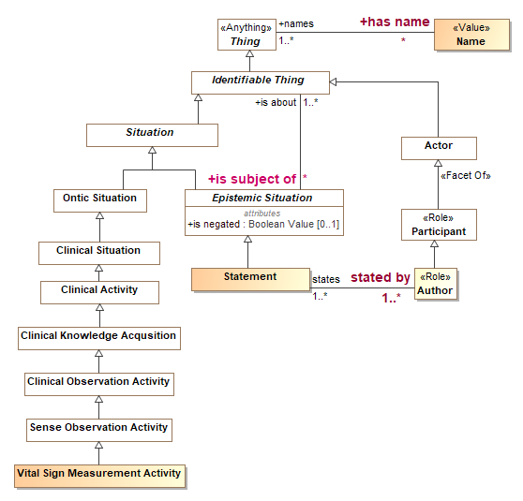
VitalSignObservationAuthorName
END
Step 5
Step 1
Making this tractable and understandable is the next challenge…
Step 2
Step 3
Step 4
Starting point

Slide 15
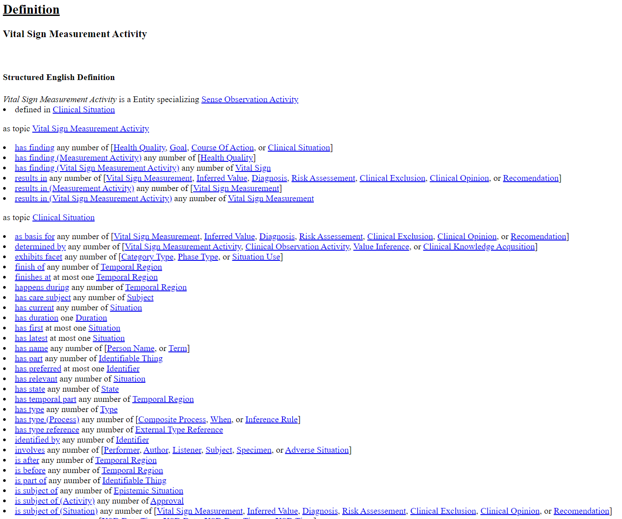
Starting point
Experimental Tooling
“Flattens” the model to enable following and restricting paths
Step 1

